Slide 1
Lecture 5bis Divide and Conquer

Slide 2
Contents
Divide and Conquer Approach
Examples
Merge sort
Finding the maximum of an array
Binary Search
Matrix multiplication

Slide 3
Divide and Conquer Approach
The problem is divided in several smaller instances of the same problem
The subproblems must be independent (each one will be solved at most once)
They should be of about the same size
These subproblems are solved (by applying the same strategy or directly – if their size is small enough)
If the subproblem size is less than a given value (critical size) it is solved directly, otherwise it is solved recursively
If necessary, the solutions obtained for the subproblems are combined

Slide 4
Divide and Conquer Approach
Divide the problem into a number of subproblems that are smaller instances of the same problem.
Conquer the subproblems by solving them recursively. If the subproblem sizes are small enough, however, just solve the subproblems in a straightforward manner.
Combine the solutions to the subproblems into the solution for the original problem.

Slide 5
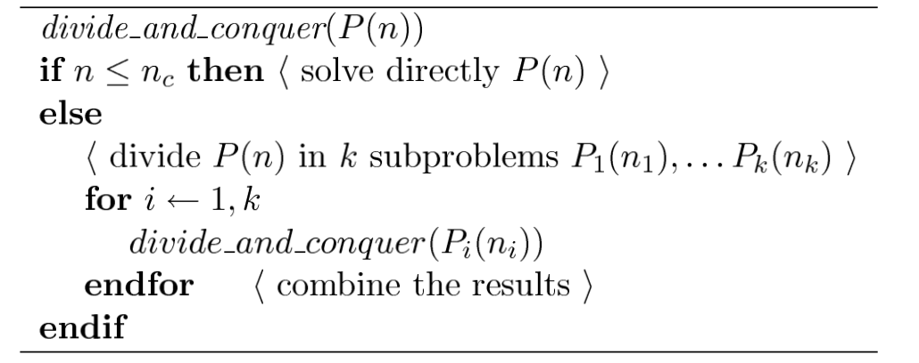
Divide and Conquer Approach
General algorithm

Slide 6
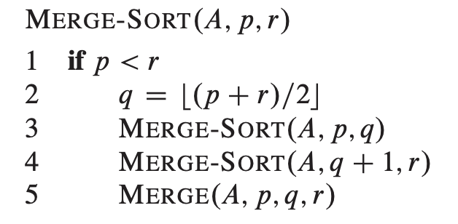
Merge sort
The merge sort algorithm
Divide: Divide the n-element sequence to be sorted into two subsequences of n=2 elements each.
Conquer: Sort the two subsequences recursively using merge sort.
Combine: Merge the two sorted subsequences to produce the sorted answer.

Slide 7
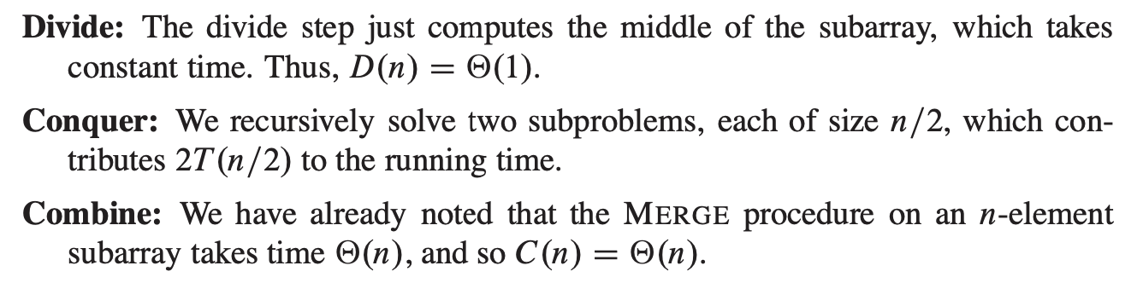
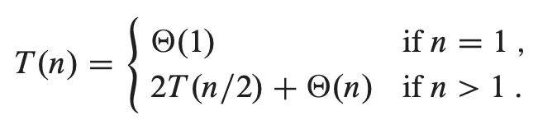
Merge sort
Algorithm analysis

Slide 8
Compute the maximum of an array
Compute the maximum of an array x[1..n]
3 2 7 5 1 6 4 5
n=8, k=2
3 2 7 5
1 6 4 5
Divide
Conquer
3 2
7 5
1 6
4 5
3 7
6 5
Combine
7 6
7

Slide 9
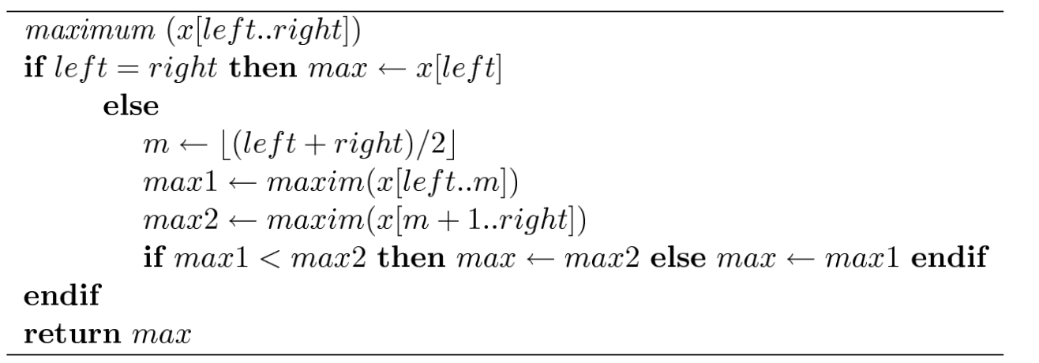
Compute the maximum of an array
Algorithm

Slide 10
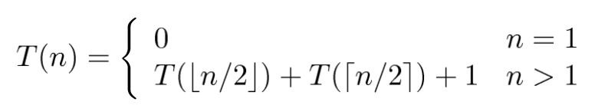
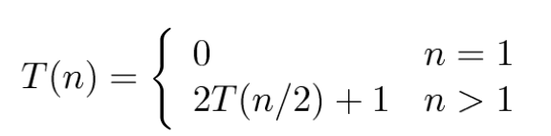
Compute the maximum of an array
Running time evaluation
T(n) = ?

Slide 11
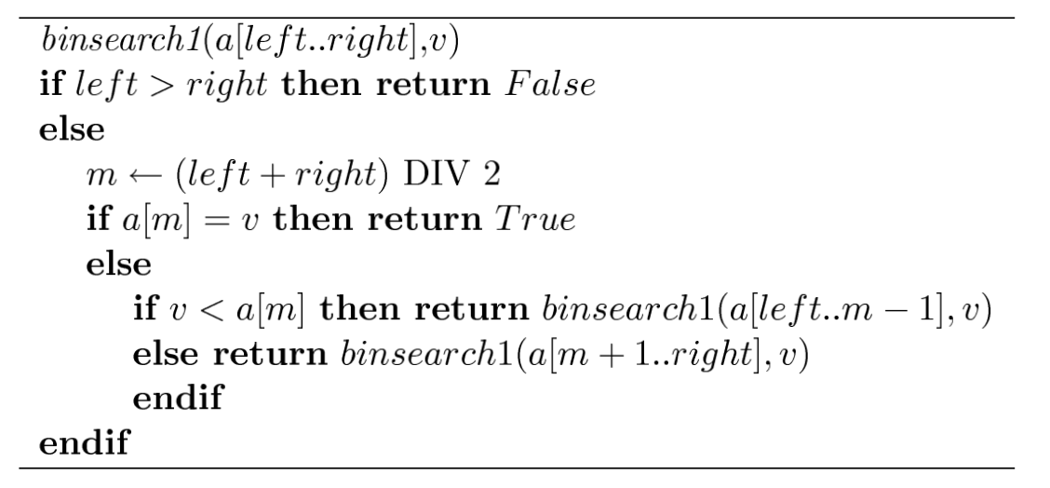
Binary Search
Algorithm

Slide 12
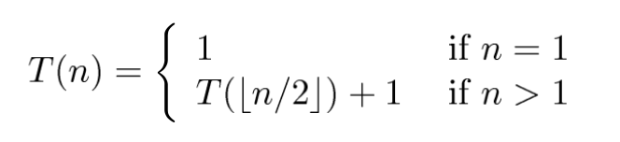
Binary Search
Algorithm analysis
T(n) = ?

Slide 13
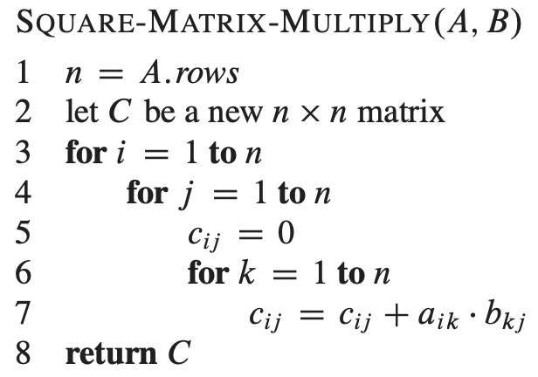
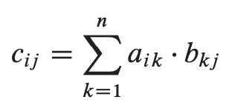
Matrix multiplication
A, B, C are square n*n matrices
Computing C = A.B
T(n) = O(n³)

Slide 14
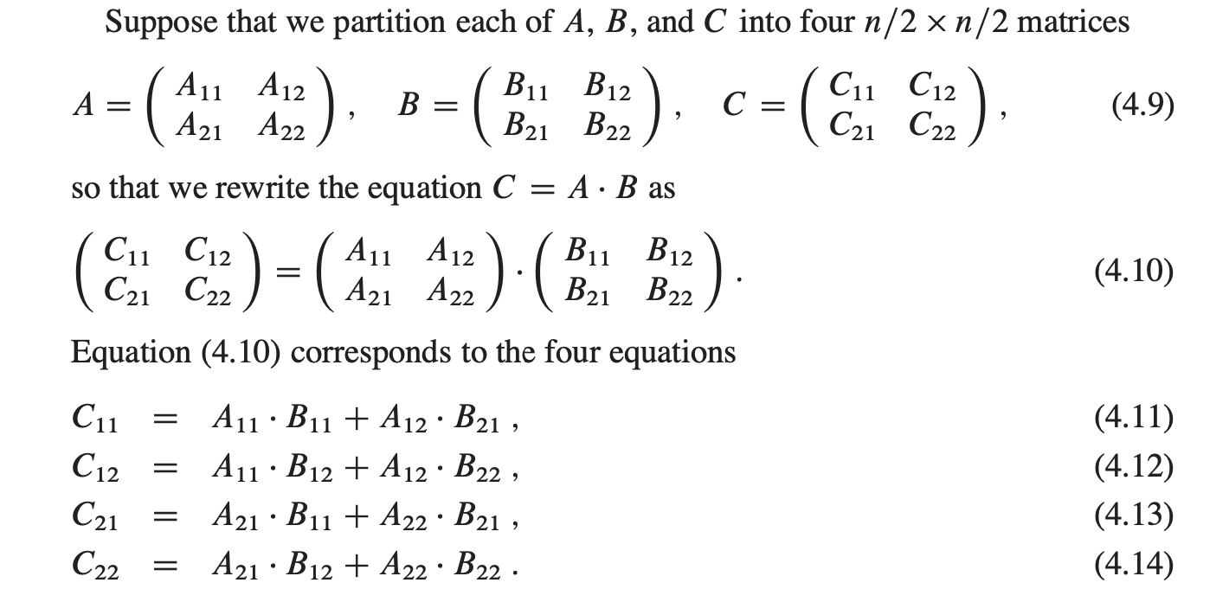
Matrix multiplication
A simple divide-and-conquer algorithm

Slide 15
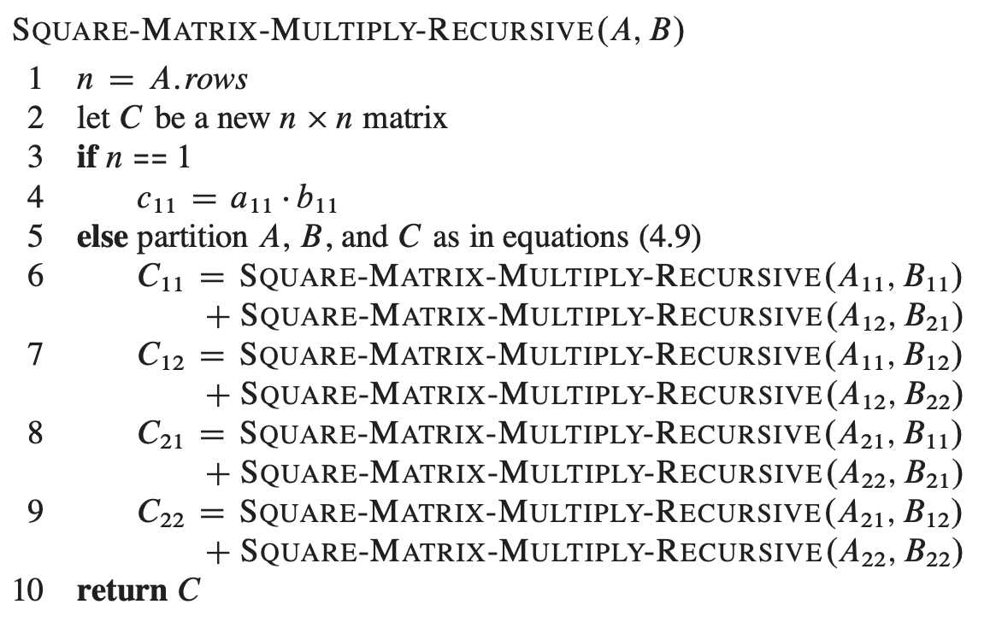
Matrix multiplication
A simple divide-and-conquer algorithm

Slide 16
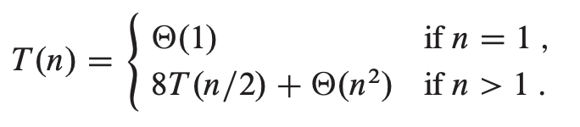
Matrix multiplication
A simple divide-and-conquer algorithm
T(n) = ?

Slide 17
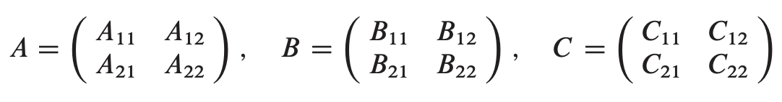
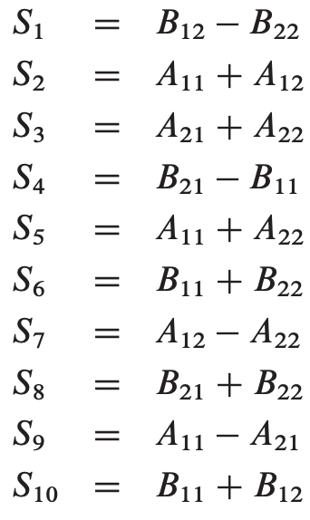
Matrix multiplication
Strassen’s method

Slide 18
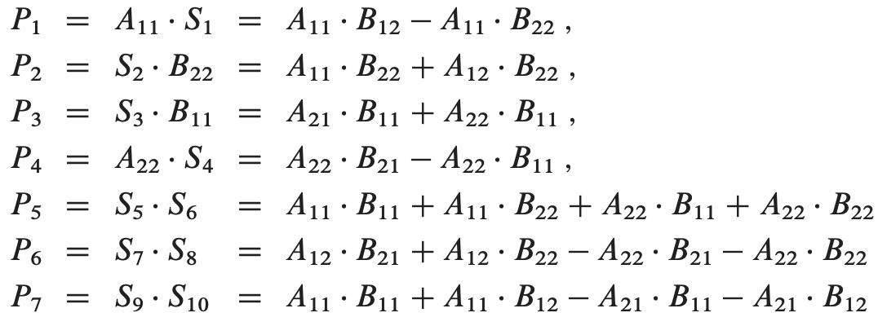




Matrix multiplication
Strassen’s method

Slide 19
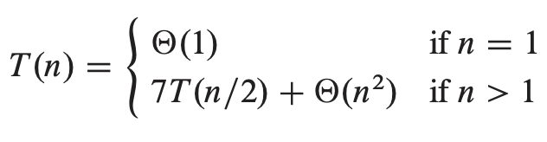
Matrix multiplication
Strassen’s method
Prove T(n) = 𝜣(n^{log 7}) ≈ 𝜣(n^{2.8})

Slide 20
Practice Problems
Problem 1. Prove that it is possible to multiply two polynomials ax+b and cx+d with only 3 multiplications (Hint: one of the multiplications (a+b)(c+d)).
Problem 2. Develop two algorithms Divide and Conquer to multiply two polynomials of degree n with the complexity
The first algorithm needs to divide the polynomial into two polynomials, one half has degree n/2 (exponent [0..n/2]) and the other half has degree n (exponential [n/2+1..n ]).
The second algorithm needs to divide the polynomial into two polynomials, half with even exponents, half with odd exponents.

